Slide 1


Food Trend Analysis on Facebook
Exploring what people talk about, how they feel, and which food items are rising in interest across Facebook posts and surveys. Combines large-scale social data, NLP, and dashboard-driven visualizations.
TEAM PROJECT
COURSE: DATA VISUALISATION

Slide 2
Our Project Team (BATCH - 2 | GROUP - 2)📊
Meet the dedicated individuals driving this initiative forward.
ABHISHEK P K
DHARSHINI S
PRINCE THAKUR
AGILAVANI T
VISHNU VARDHAN DERANGULA
MAHITA CITEWAR

Slide 3
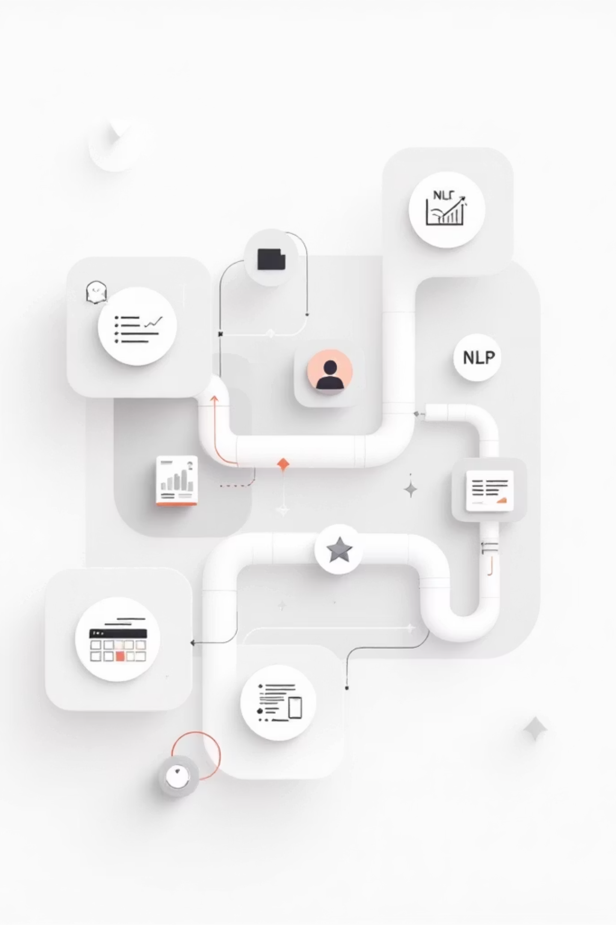
Project Snapshot
Objective: Analyze Facebook food-related content and survey responses to surface trends, sentiment, and actionable insights for food brands and researchers.
Scope
Data Volume
Facebook posts, comments, reactions, and a complementary user survey.
~62,000 unstructured records + ~3,900 survey responses.
Deliverables
Cleaned dataset, NLP outputs (sentiment, keywords), multidimensional model, Power BI dashboard.

Slide 4
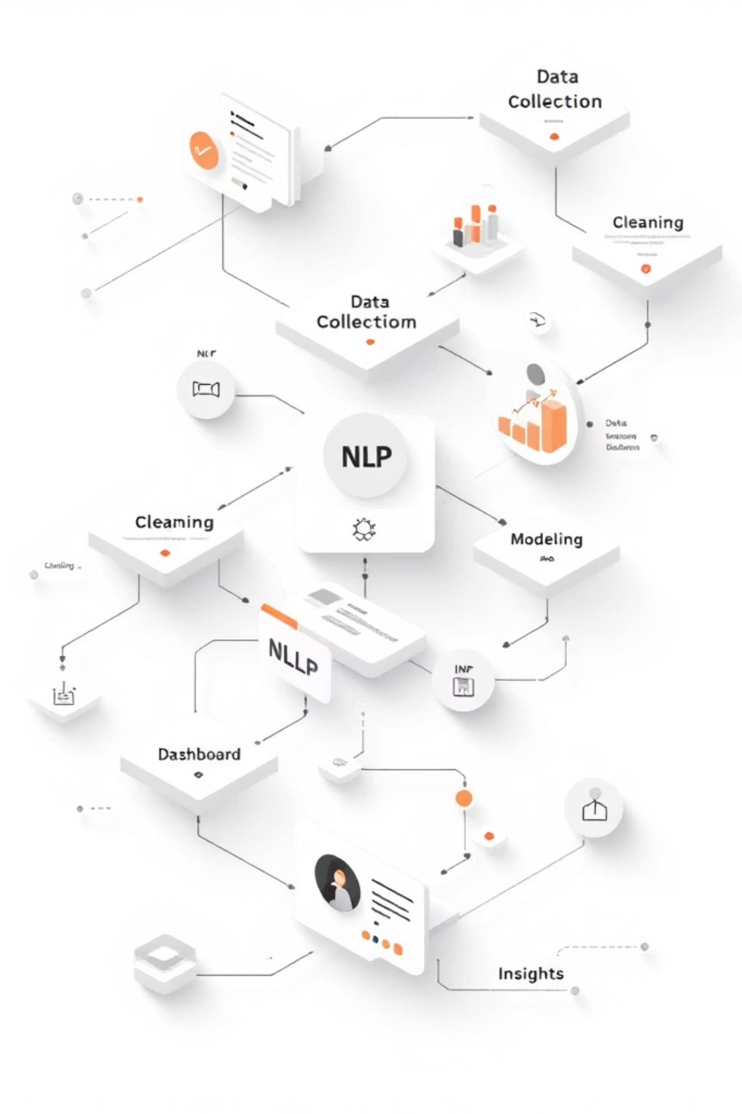
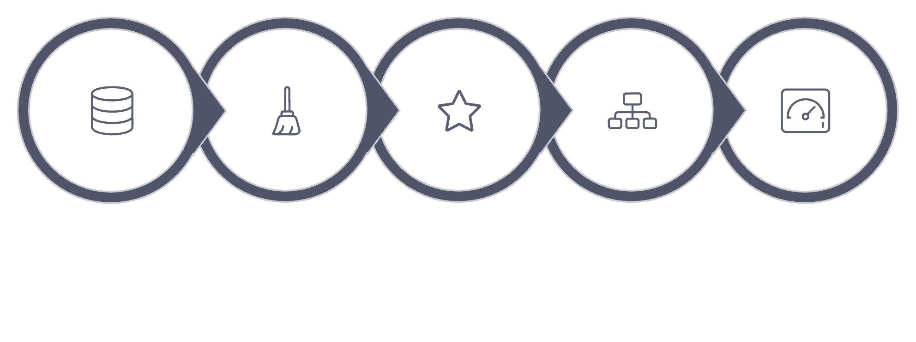





Workflow — End-to-End Pipeline
Data Collection
Data Cleaning
NLP Processing
Data Modeling
Dashboard
Data moves from raw scraping through iterative cleaning and NLP pipelines into a structured multidimensional model, then into Power BI for interactive exploration and insight extraction.

Slide 5
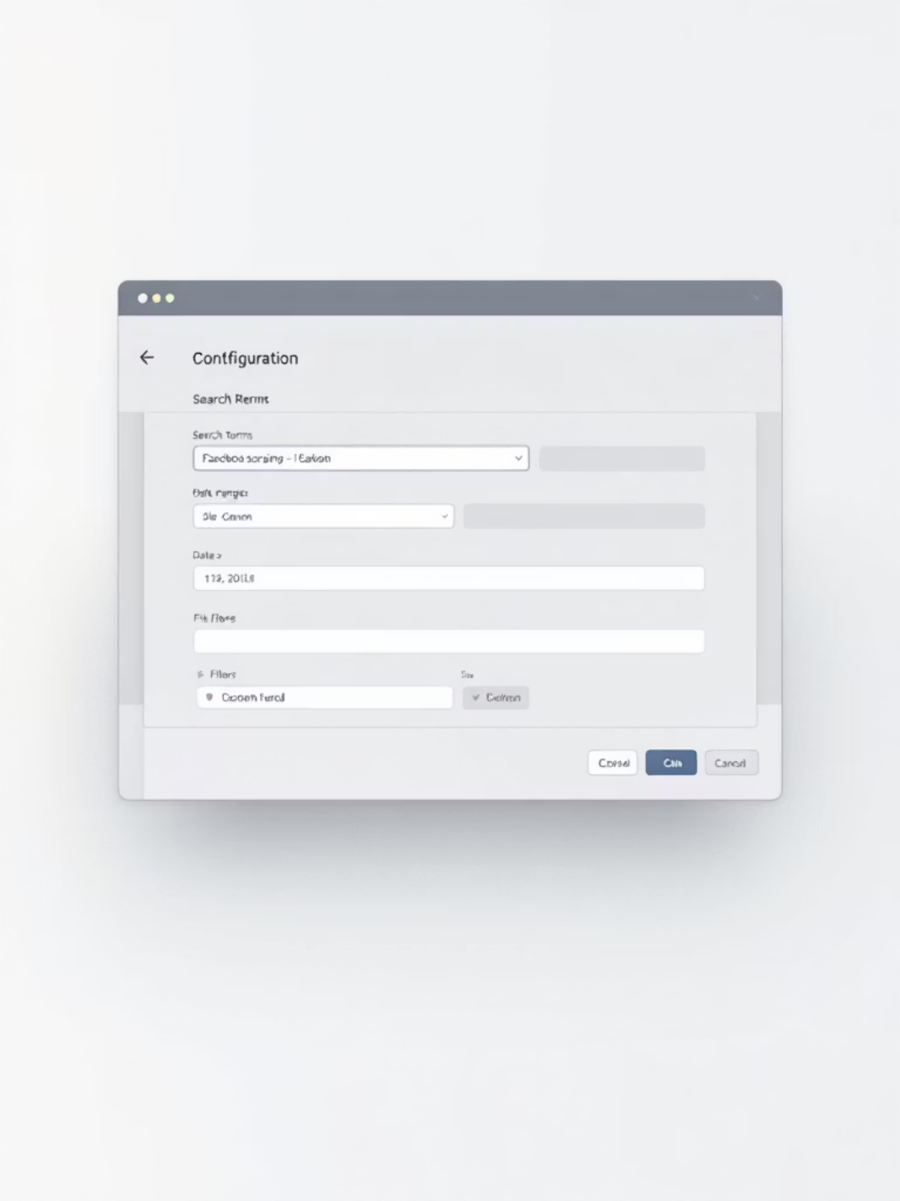
Data Collection — Overview
Unstructured Facebook data collected using Apify scrapers: posts, comments, reactions, and timestamps. Inputs included URLs of various Facebook pages and posts.
Unstructured (Facebook)
Structured (Survey)
Tool: Apify Scraper • Volume: 62,000+ records
Method: Online survey • Responses: 3,900+ • Demographics and preferences

Slide 6
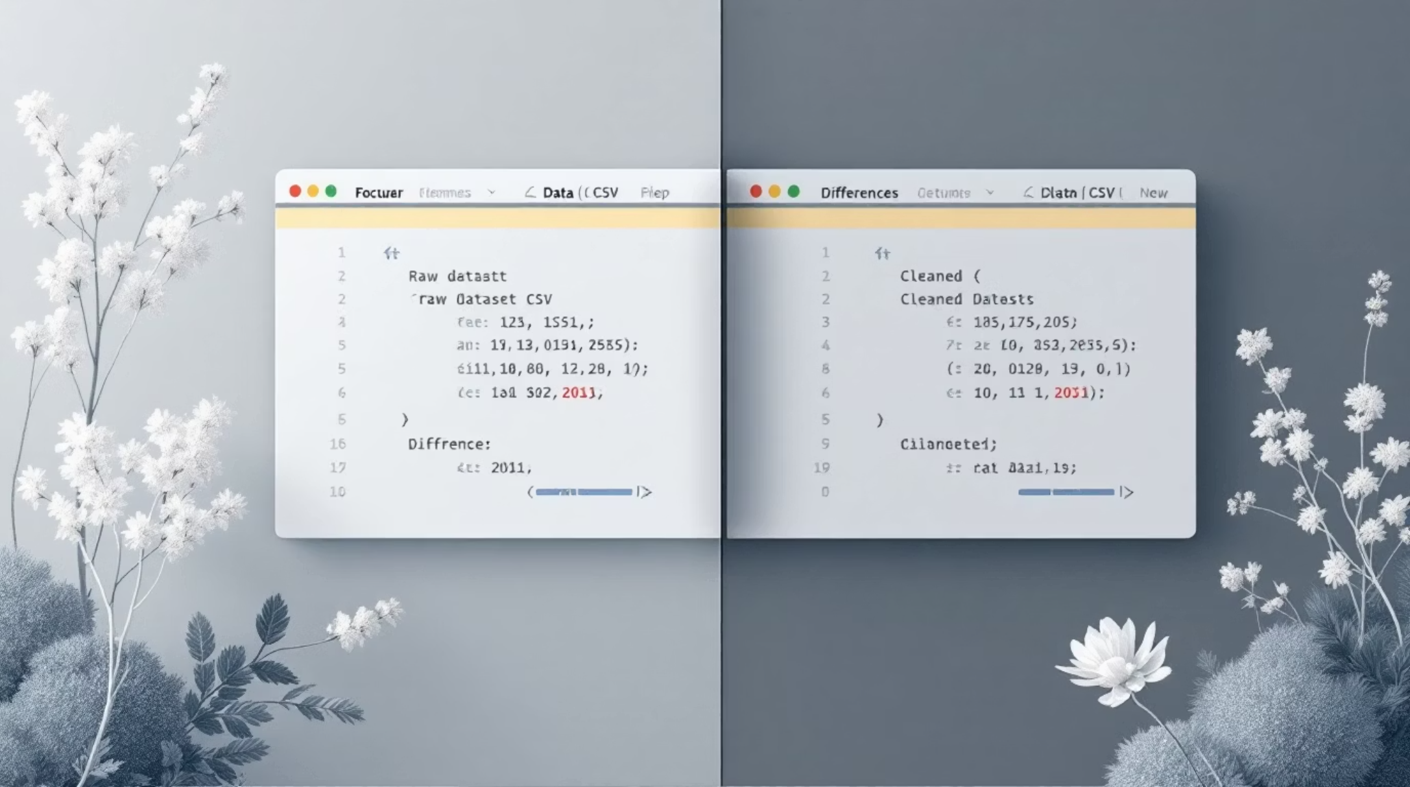
Data Cleaning — Key Steps
Removed irrelevant or duplicate columns and rows.
Handled missing values with targeted imputation or exclusion.
Converted types (dates, numeric scores) and standardized timestamps (UTC).
These steps ensured consistency across sources and enabled reliable joins into the multidimensional model.

Slide 7



NLP Processing
Transforming unstructured text data from Facebook posts and survey responses into actionable insights using advanced linguistic techniques.
Sentiment Analysis
Keyword Extraction

Slide 8
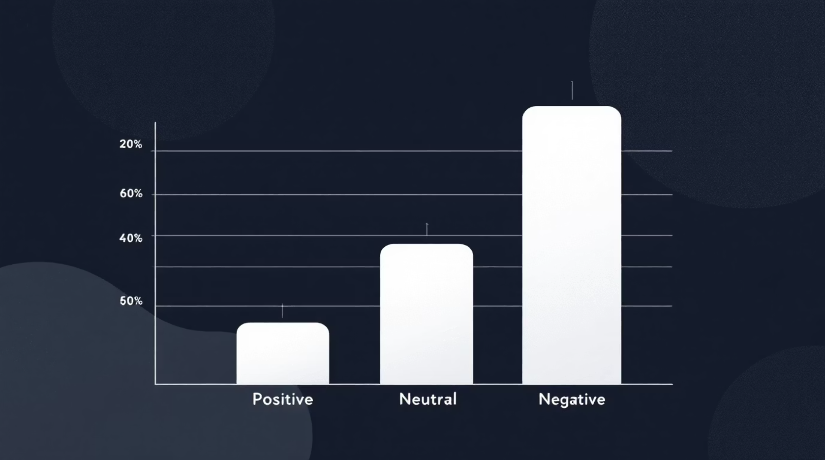
Sentiment Analysis — Overview
Using VADER, we assigned sentiment scores and categorical labels to comments and survey feedback. This enabled sentiment trend tracking across food categories and time windows.

Slide 9
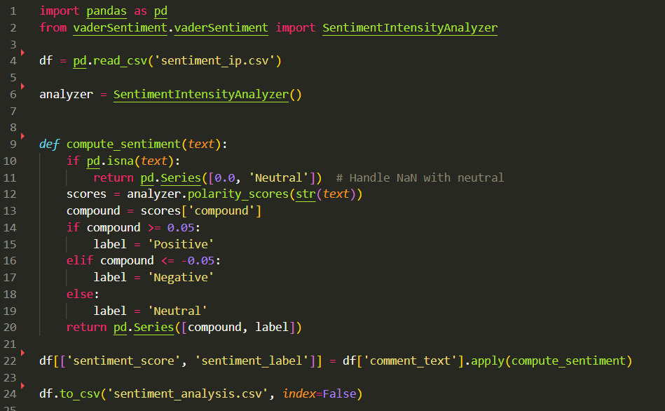

Slide 10


Keyword Extraction — Highlights
Extracted the names of food items from the post description for deep understanding of the posts.

Slide 11
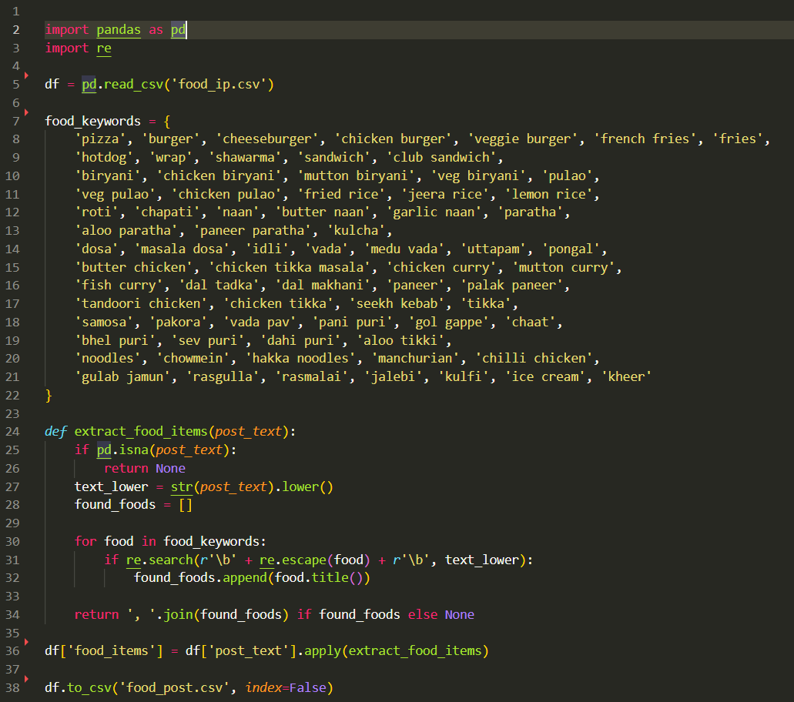

Slide 12
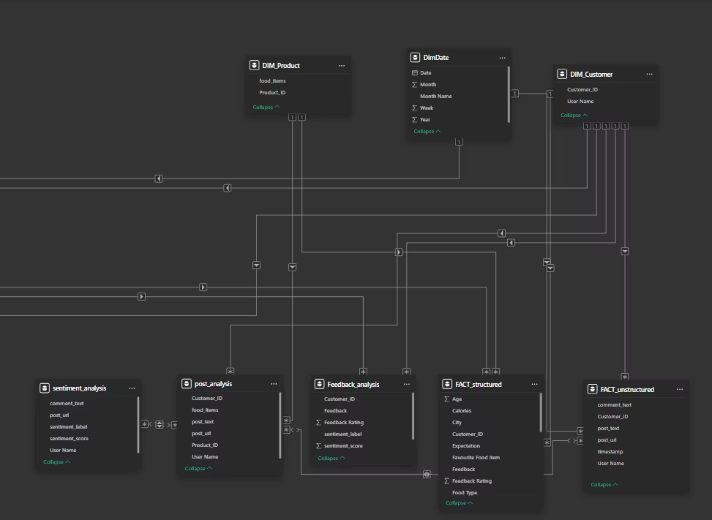
Data Modeling — Structure
Implemented a multidimensional model to support fast analytical queries and dashboard visuals.

Slide 13
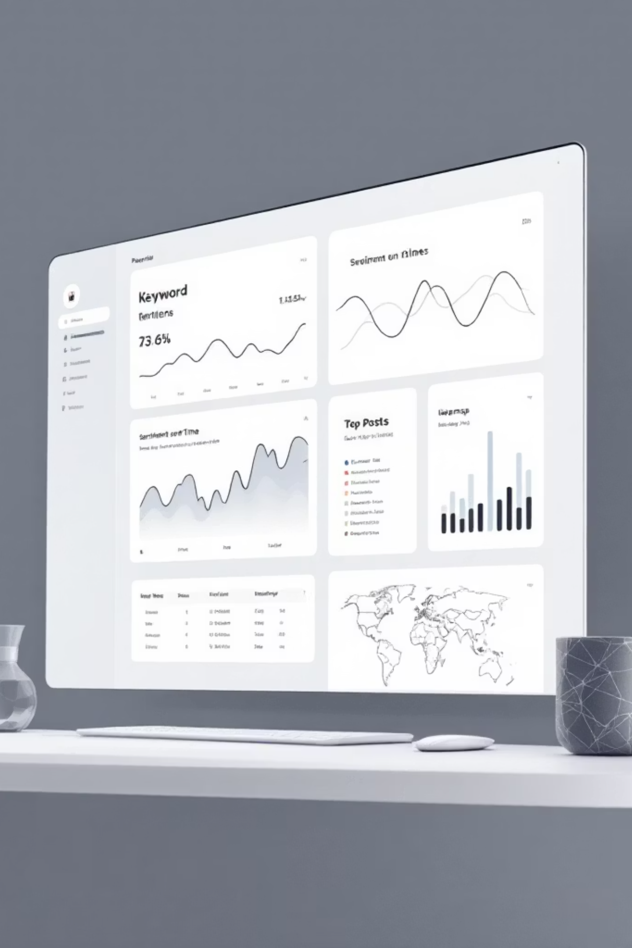

Dashboard — Food Trend Analysis in Facebook
Interactive Power BI dashboard surfaces:
Time-series of top food keywords and mention volume
Sentiment trendlines by category
Top-performing posts and engagement metrics
Geographic distribution and demographic breakdowns
Live walkthrough planned — visuals are intentionally minimal on slide to allow live explanation.

